Slide 1
Development of flood monitoring and early warning system

Slide 2
Sub title
Objectives
Problems statement
Architucture
Hardware requirements
Software requirements

Slide 3
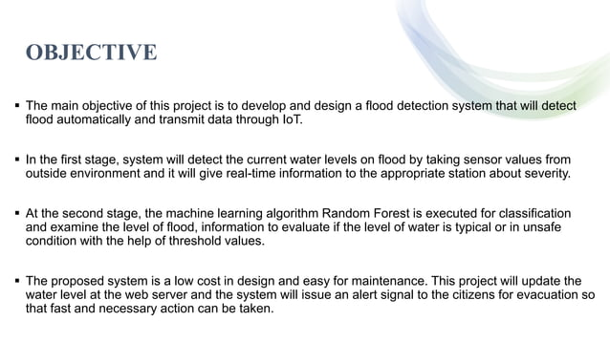

Slide 4
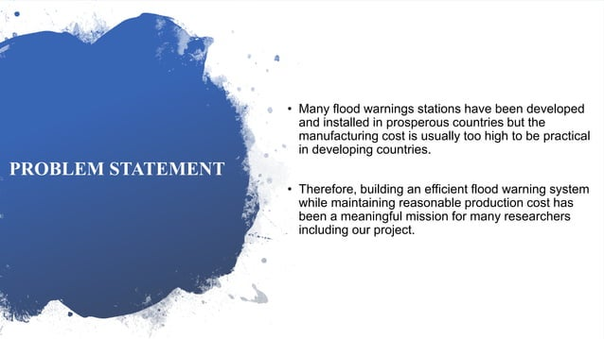

Slide 5
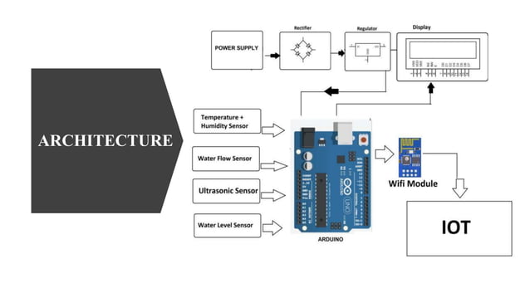

Slide 6
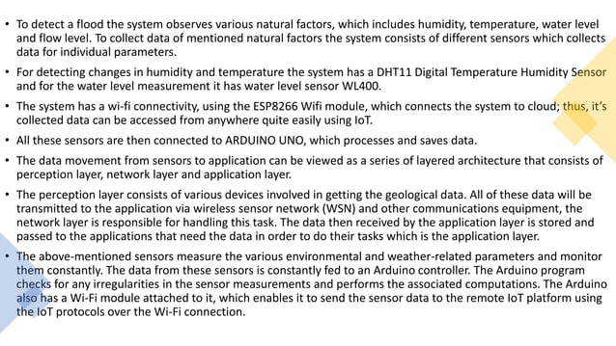

Slide 7
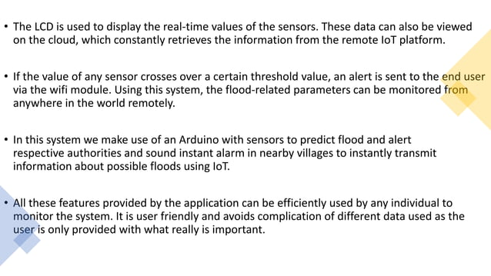

Slide 8
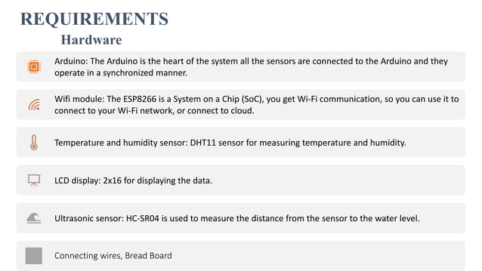

Slide 9
